Slide 1
Our Professional Services
HR Framework & Organizational Design: Build comprehensive HR frameworks, organizational structures, and empowerment strategies to align with business goals and market demands.
Compensation & Incentive Systems: Design grading/salary structures, performance-based incentives, profit-sharing plans, commissions, and long-term incentives to motivate and retain talent.
Performance Management: Implement goal-based systems, competency assessments, and productivity analyses for optimized performance tracking and improvement.
Talent Development & Assessment: Create unified competency models, talent development programs, assessment initiatives, and learning platforms with gradient plans for key talents and management trainees.
Digital HR Transformation: Champion HR digitalization projects, including SAP SuccessFactors implementation, payroll/attendance interfaces (e.g., ADP), and data mining for enhanced efficiency.
Shared Service Centers (SSC): Establish group-level SSCs to shift HR focus from operations to strategic partnering, with process and data improvements.
M&A HR Support: Lead HR aspects of mergers, including productivity deep-dives, organizational blueprints, headcount optimization, talent assessments, staff assignments, and communication plans.
Recruitment & Staffing Optimization: Enhance staffing for new departments, digitalize job profiles, and integrate with external platforms for precise talent matching and allocation (e.g., digital patient systems in healthcare).

Slide 2
Projects Brief
A NASDAQ listed company
Customer Initial Requirements:
Assigned by Invetor (PE), to provide Interim HR Management aiming at
  Build HR management framework by transforming/ enabling current HR team, in specific to realize 3 pillars structure
  Work closely with top management, to establish solid talent backbone for company’s secondary listing (new BU)
Deep Dive upon baseline investigation:
Current HR team members mostly play hybrid role of business partner + function specialists, which lead to chaos and Inefficiency
There is no HRBP could really concentrate on business strategic supporting, especially identify talent shortage for upcoming new business unit
There is no authoritative COE to govern necessary rules
There is no dedicated SSC to ensure accurate executions

Slide 3
Projects Brief
A NASDAQ listed company (continued)
What we Delivered
On-site interim management for over 6 months.
Developed a state-of-the-art HR management framework at the group level, encompassing all three distinct business units.
Established a Group SSC and COE to shift HRBPs' focus from operational tasks to strategic business partnering, to contribute against organizational and talent needs specific to each business Units.
Reviewed all HR functions and provided 1:1 coaching to empower relevant stakeholders.
Created a unified competency model covering key functions across the Group which can be used for talent pipelining in new BU.
Conducted an Assessment Program for all key talents.
Led the construction of a learning platform, incorporating gradient learning plans tailored to the competency model of each position.
Enhanced recruitment efficiency by optimizing collaboration with external platforms using digitalized job profiles.

Slide 4
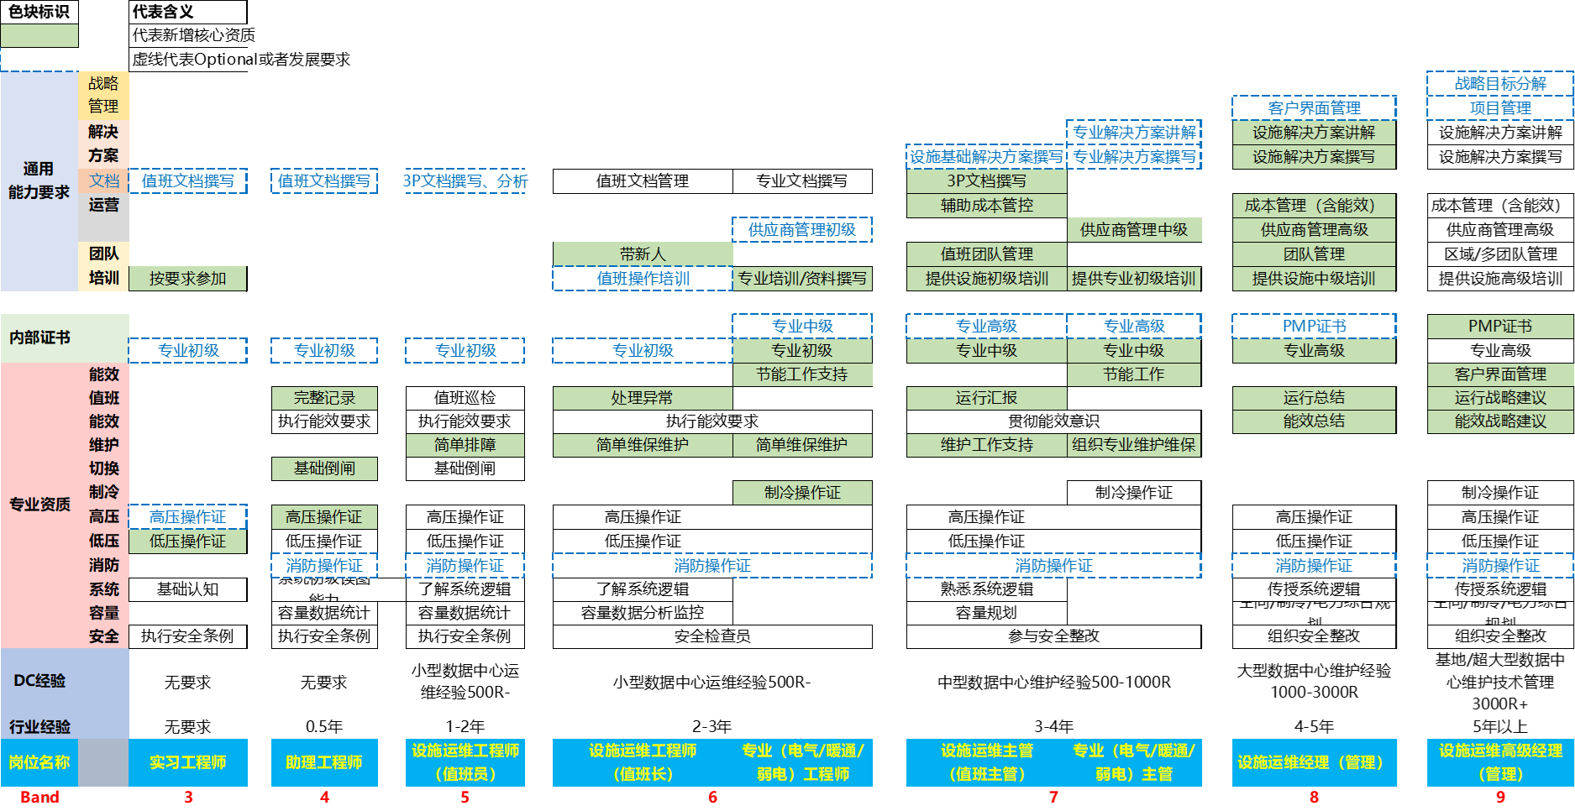
Projects Brief
A NASDAQ listed company (continued – typical products)
Competency Model Sample

Slide 5

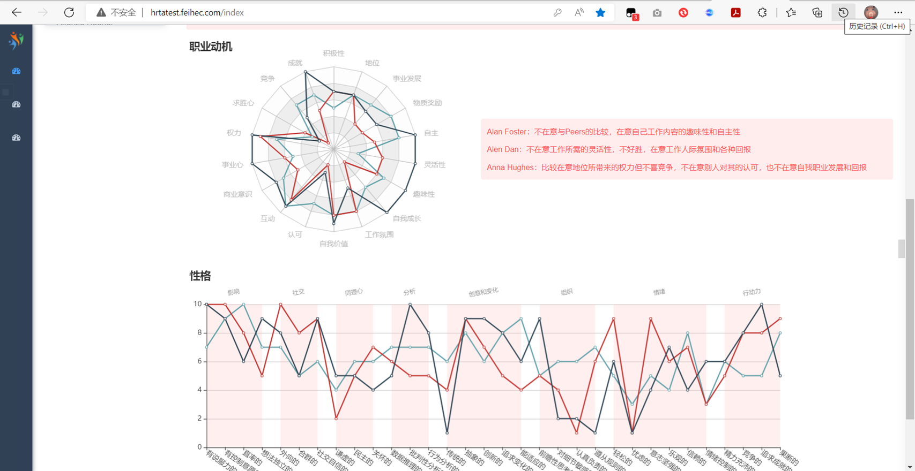
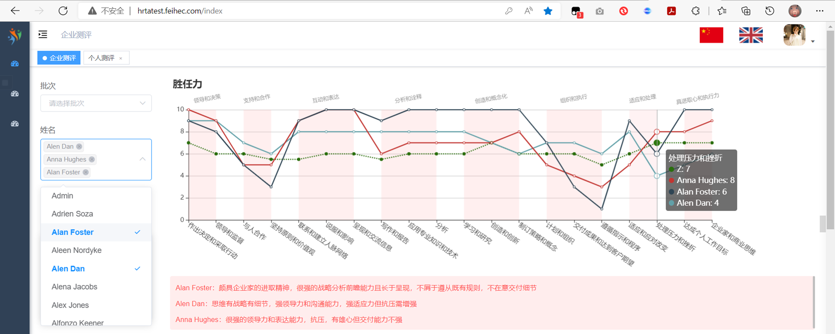
Projects Brief
A NASDAQ listed company (continued – typical products)
Competency Based Talent Tracking System

Slide 6
Projects Brief
A State-Owned Engineering Group
Customer Initial Requirements:
To find a smooth solution aiming at souring adequate proper technical engineers for ad-hoc projects
Deep Dive upon baseline investigation:
The talent pool are always existing in form of discrete staffing papers associated with historical projects
Need to build a system which is capable to
  Track useful competency information of existing engineers
  Collect information from new capture competency information in structured way
  Establish digital competency profile DB for all above
  Develop algorithm to match project demand quickly and accurately
  Track performance under each project and make it useful reference for future match

Slide 7
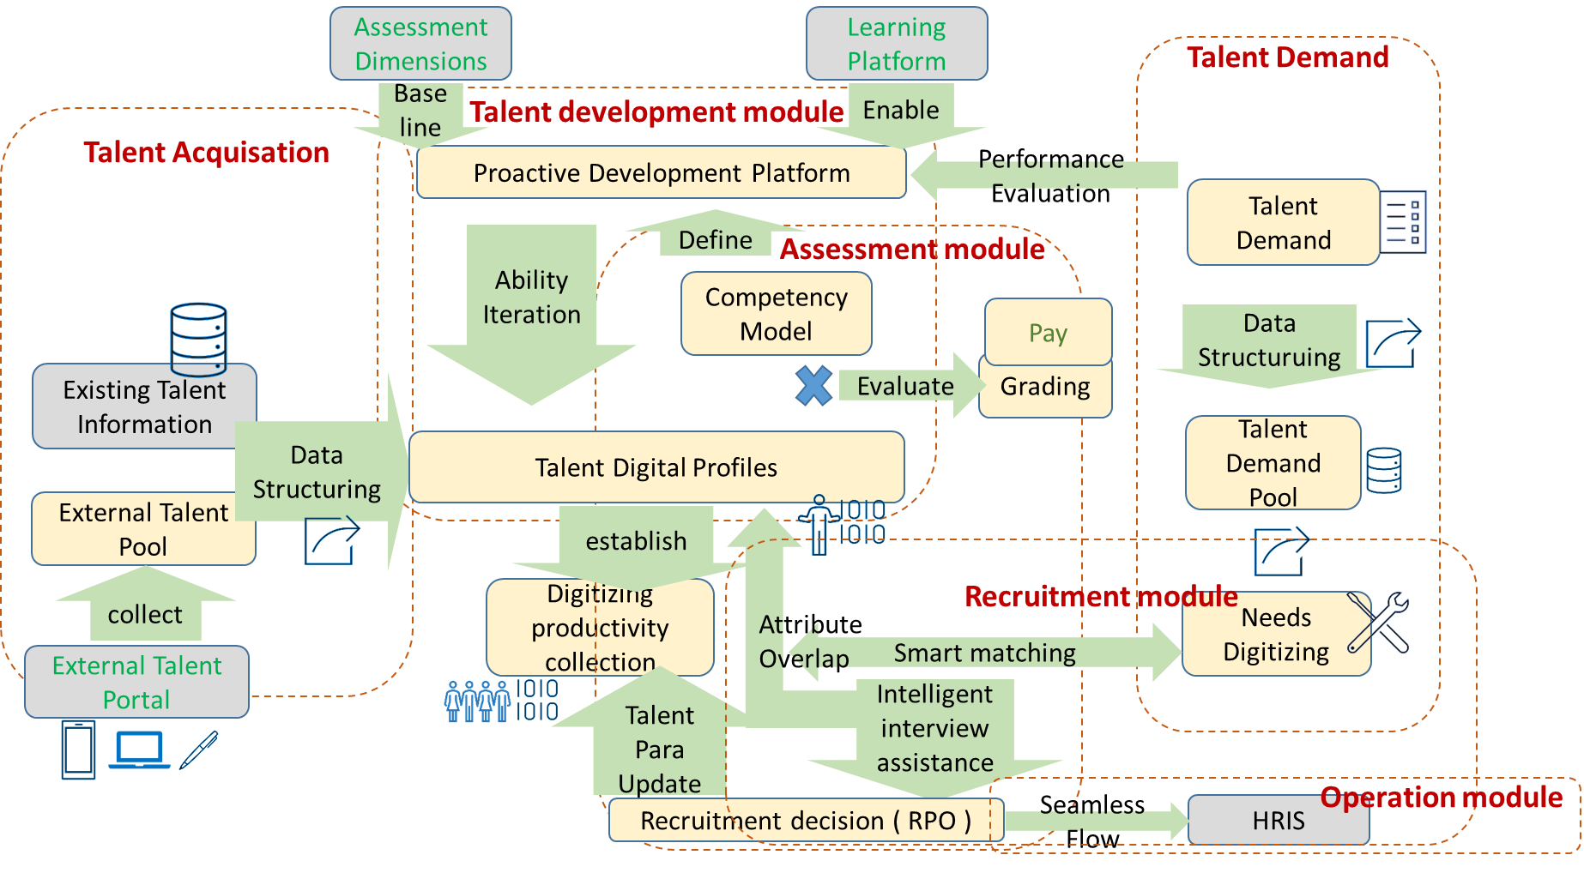
A State-Owned Engineering Group
What we Delivered – Talent Sourcing system Smartisans

Slide 8
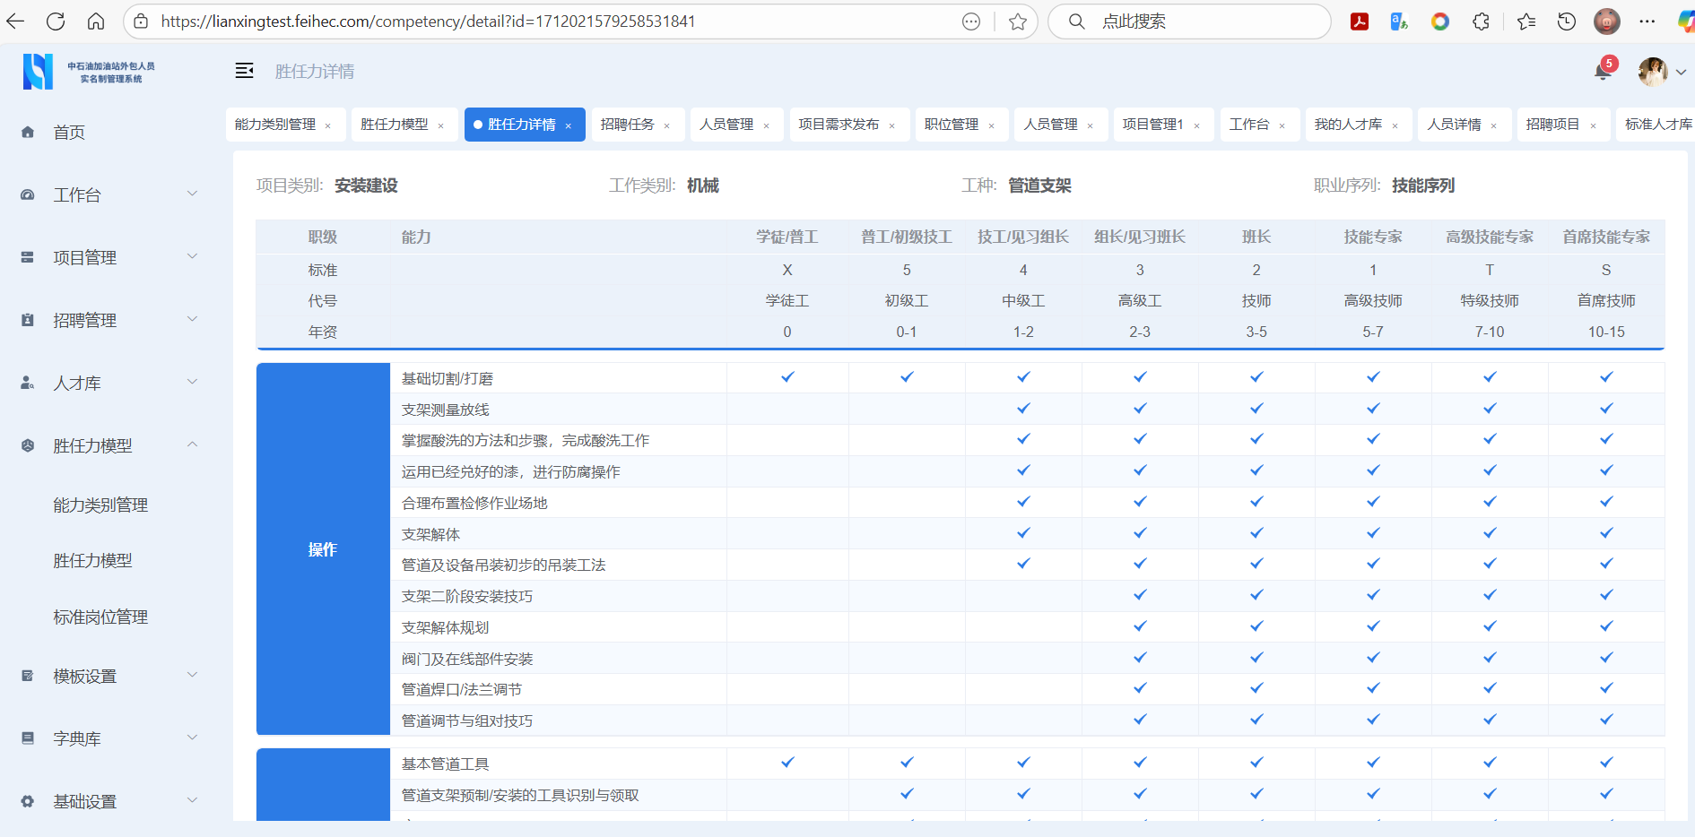
Projects Brief
A State-Owned Engineering Group
What we Delivered – Talent Sourcing system Smartisans

Slide 9
Projects Brief
A Global mining giant
Customer Initial Requirements:
Assigned by Global HR to provide HR consulting service across APAC + EMEA, with focus on
  Streamline HR organization by reviewing and coaching current HR team in COE+SSC
  Work closely with global project team, to ensure SAP SF’s on time deployment in region
Deep Dive upon baseline investigation:
Current HR internal knowledge are managed almost offline by certain people, with confused understanding among team
SSC are very country focused (not really region SHARED) although we see huge value harmonizing most of practices across multiple countries
Lack of vehicles to help SSC to work in modern way
Low level of SSC engagements on SF deployment
Notes:
Customer Initial Requirements:
Assigned by Global HR to provide HR consulting service across APAC + EMEA, with focus on
Streamline HR organization by reviewing and coaching current HR team in COE+SSC
Work closely with global project team, to ensure SAP SF’s on time deployment in region
Deep Dive upon baseline investigation:
Current HR internal

Slide 10
Projects Brief
A Global mining giant (continued)
What we Delivered
Led HR transformation project (extended to two years) for APAC + EMEA regions by using SAP SF deployment as a handle of enhancing HR management framework.
Developed interfaces with Payroll and Attendance systems (ADP), to let SSC to quickly find their values under new platform
Coordinated integration testing by deeply involving ALL SSC (plus HRBP+COE)
Directed HR Shared Service Center (SSC) in APAC/EMEA to drive data and process improvements via new tech, e.g.MS 365
Supported Total Rewards team in establishing more reliable compensation/ benefits framework across the region.
Assisted in refining the Year-End bonus process and set the rules for future
Coached HR colleagues in the SSC and Total Rewards teams.

Slide 11
Projects Brief
A leading Baijiu brand
Customer Initial Requirements:
Make HR a key driver to realize the goal of 2X revenue in 3 years
Establish HR team to support sustainable development of business
From organizational perspective review business structure to fir modern business environment
Deep Dive upon baseline investigation:
Current business team is very reliable on execution of superior’s command, while lack of self-motivation upon micro goals of own
Current HR team are led by business leader who is no doubt with loyalty and passion but lack of expertise as HR.
Most revenue are realized via existing traditional channels, with little space to surge further unless meaningful (qualified) teams of Marketing, Trade Marketing and E-Trade are built.

Slide 12
Projects Brief
A leading Baijiu brand (Continued）
What we Delivered
Human Resources Consulting Services with at least 2 years of long-tail tracking and support.
Developed a comprehensive HR framework, including organizational design and empowerment strategies.
Designed a grading system to ensure competitive/fair compensation.
Implemented a goal-based performance management system for measurable outcomes of all key contributors.
Established a performance bonus system to reward achievements.
Created a commission system to incentivize sales and performance.
Introduced a long-term incentive plan to retain top talent.
Formulated a Talent Development Plan to enhance employee growth.
Developed a solid Management Trainee Development Plan to nurture future leaders.
Built teams of Marketing, Trade Marketing and E-Trade with modern definitions.

Slide 13
Projects Brief
An agricultural technology company
Constructed an overall HR framework to align with organizational goals.
Designed organizational structure and empowerment strategies to enhance efficiency.
Developed a grading and salary system to ensure equitable compensation.
Implemented a performance incentive program to motivate employees.
Designed a long-term incentive plan to retain key talent.
Launched a Talent Development Program to foster professional growth.
Established the Group's Shared Service Center to streamline HR operations.
Drove digital transformation to modernize HR processes.

Slide 14
Projects Brief
A dental chain enterprise
Developed an overall HR framework to support organizational objectives.
Designed organizational structure and empowerment strategies to enhance leadership
Implemented business-specific competency assessments and a digital patient allocation system for optimized resource management.
Created profit-sharing plans by clinic to foster an entrepreneurial spirit among staff.
Constructed a grading/salary system and designed performance incentives and long-term incentive plans to drive motivation and retention.

Slide 15
Projects Brief
Nation-Owned distribution group
Designed organizational structure for Marketing and Trade Marketing functions to align with market demands.
Managed new department staffing and development to build capable teams.
Conducted data mining from existing business systems to empower new functions with greater confidence.
Established a mature performance-based compensation management framework to incentivize productivity.
Facilitated deployment of the above initiatives through digital solutions for enhanced efficiency.

Slide 16
Projects Brief
A M&A project for an international logistic giant
Collaborated with GPMIP as the HR champion for the entire M&A project.
Conducted a deep-dive productivity analysis to identify key insights.
Designed an organizational blueprint based on a comprehensive analysis of both parties.
Proposed an HC optimization plan integrating bottom-up analysis with top-down financial expectations.
Performed talent assessments and staff assignments to align with the organizational blueprint, including before-and-after comparisons for HC and productivity.
Prepared communication decks tailored for management, managers, and employees.
Integrated HR strategies into the overall M&A proposal for seamless execution.

